Slide 1

Kaggle: Your Machine Learning and Data Science Community
A model that predicts how much rating & views a new dataset will get in kaggle
Ziv Hochman & Anzor Torikashvili

Slide 2

What Is Kaggle?
Kaggle is an online community of data scientists and machine learning practitioners. Kaggle allows users to find and publish data sets, explore and build models in a web-based data-science environment

Slide 3
External Resources
Kaggle website

Slide 4
Data Science Phases
Scraping & Crawling
Handling Missing Data
Visualization
Machine Learning
Conclusion

Slide 5

Data Crawling & Scraping

Slide 6
Scraping & Crawling
Kaggle makes it harder for people to crawl & scrape their website in order to stay more secure. In order to achieve that they use javaScript code in the source page thus only after rendering the page will display as it should. We tried to use beautiful soup for scraping the dataset's URL for each of the datasets. Due to these circumstances we had to crawl and render the URL from every page first before we could do scraping on our data which led us to use Selenium. With selenium we were able to acquire the URLs of the datasets and begin with the scraping
We extracted 3 main data
URL to each DataSet
Data on each DataSet
Data on each author
We ended up with 2737x24 = 65688 blocks of data

Slide 7
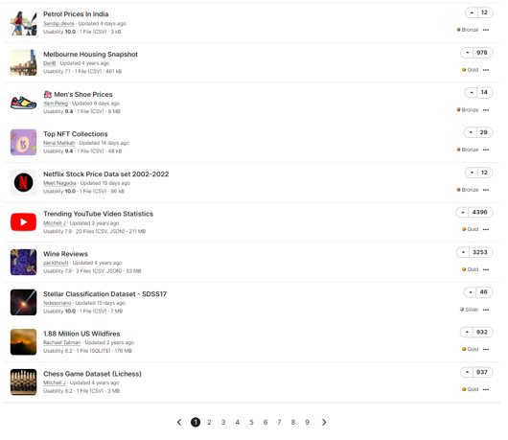
URL Of Each DataSet
Firstly, for each page (with crawling) we scrape the dataset's URL for each dataset on the page.

Slide 8
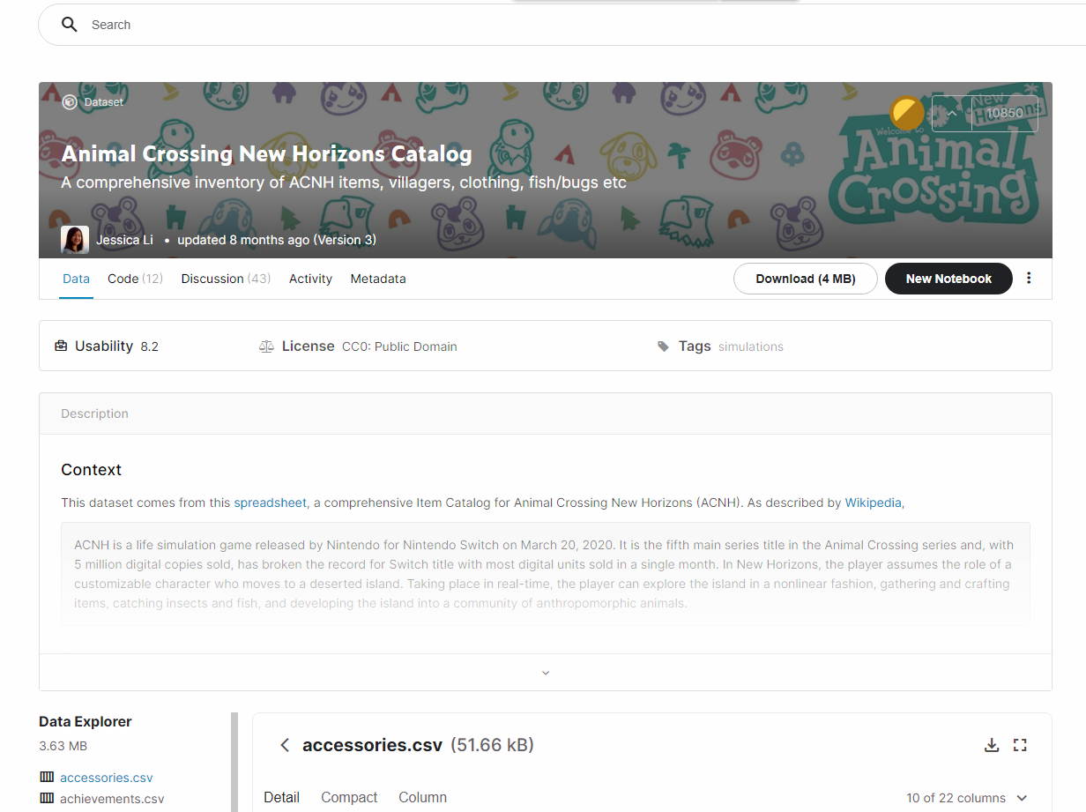
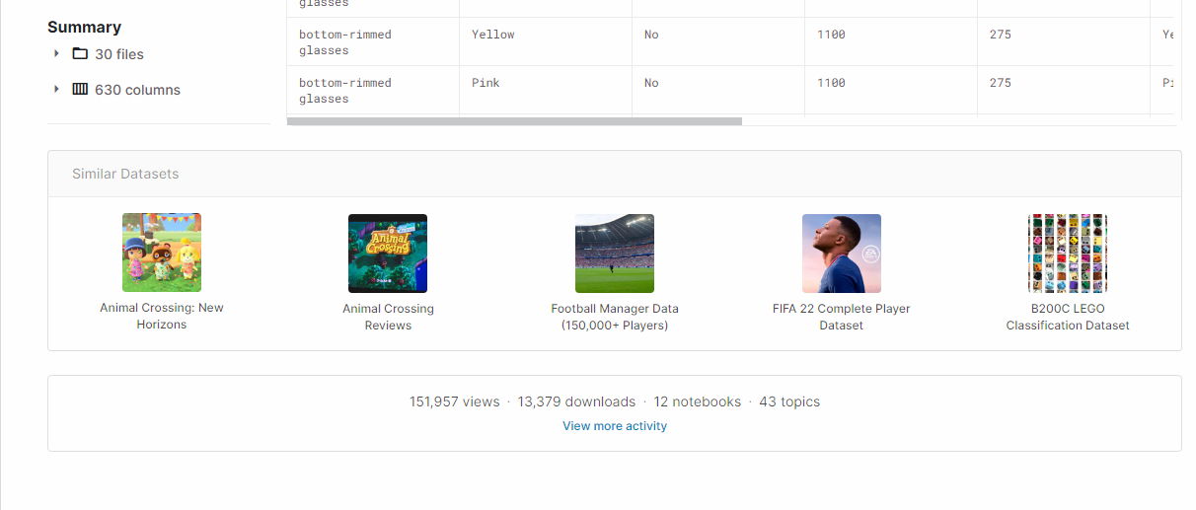
Data On Each DataSet
Secondly, for each dataset's page, we scrape: title, subTitle, author name, dataset version, date of the last update, rating, usibility, number of files, the total size of all the files, views, downloads, topics and the author's URL.

Slide 9
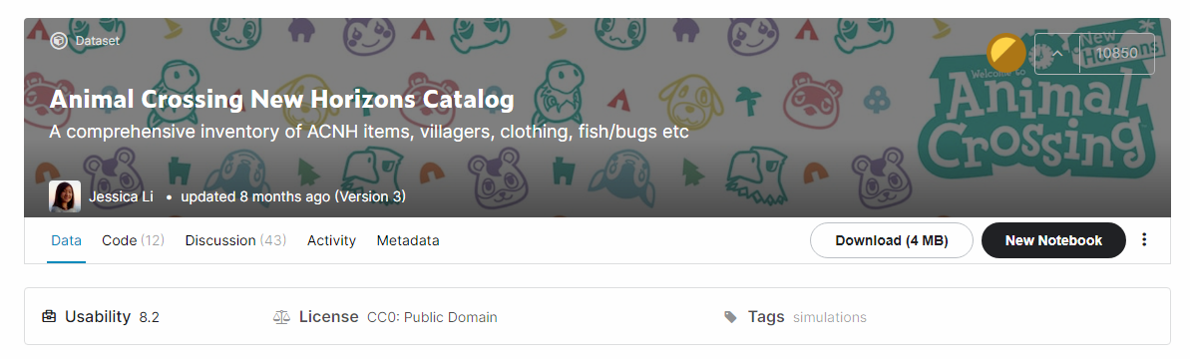
Data On Each DataSet
Once we gathered all the necessary dataset's data, we move to the author's page.

Slide 10
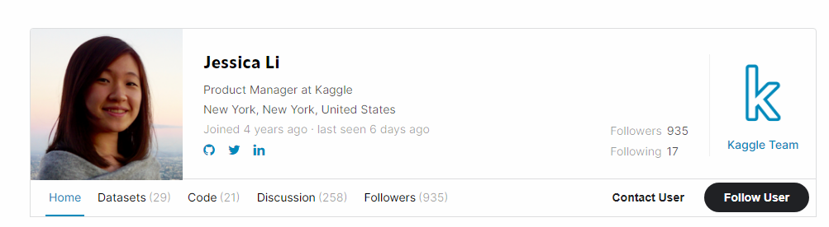
Data On Each Author
In this page we gathered the following data: location, experience num, followers, following, Owned Datasets, Code Helper, Discussion and (if possible) Competitions that the author participated in.

Slide 11

Data Cleaning

Slide 12

Data Cleaning
After we finished gathering all the necessary data we begin with the following phase of data cleaning. In this phase we have done the following:
fixing the type of each column ( for example we replaced 'a' with 1 in experience num column)
Filling up missing values with default values (for example filling up subtitle with the title of the same dataset) for some of the columns.
Checking that none of the columns have NaN values after the filling and if there are we dropped them.
Feature engineering (creating a new column for the scaling process)
After the data cleaning we were left with 56154

Slide 13

Visualizations

Slide 14
Visualizations
In this phase, once we got our data from the website and cleaned it we can begin visualization . Our purpose here is to search for some relations between columns, have an overview on the data that we collected in the soul purpose of checking if we can predict for a new dataset that has been uploaded to KAGGLE the following:
The rating of a new dataset
The views of a new dataset

Slide 15
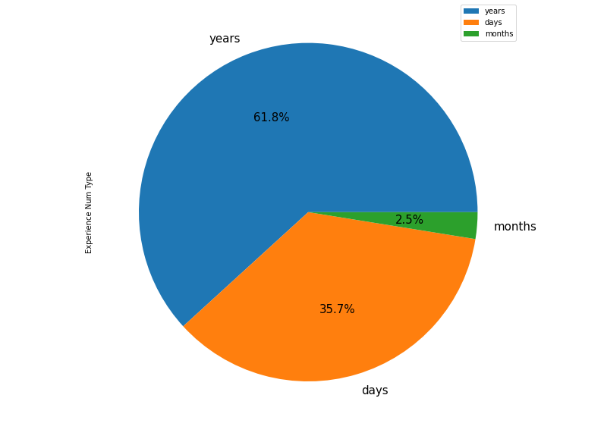
Authors Experience
We can see that most of the authors are veterans with years of experience

Slide 16
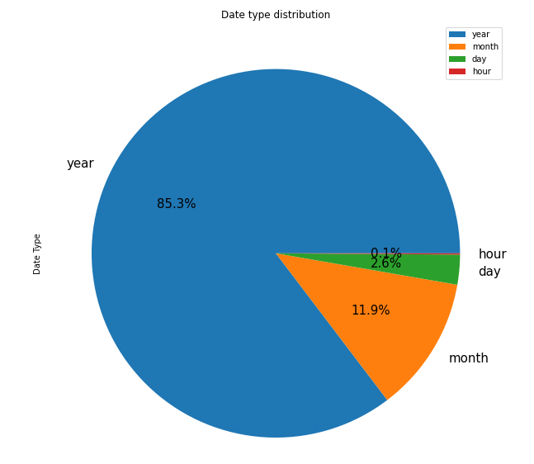
Datasets Updates
We can see that most of the datasets have been update over a year ago

Slide 17
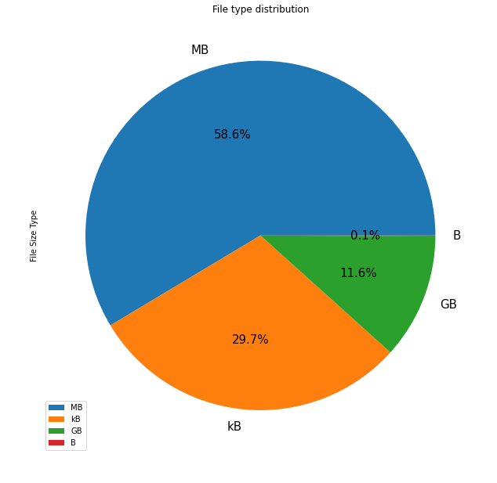
Datasets Size Type
We can see that most of the datasets are in MB which means that most of them are not big datasets

Slide 18
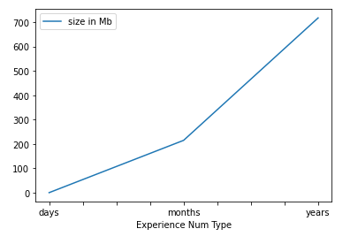
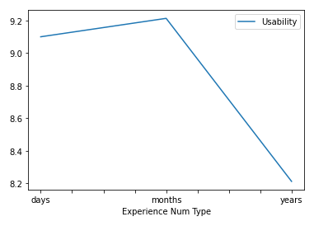
Authors Experience Affect Usibility And Dataset Size
In regard of the information shown in the graphs, it is highly notable that the least accomplished authors focus more on usability of the data while the more accomplished authors focus on the quantity of the information regarding the topic in the database

Slide 19
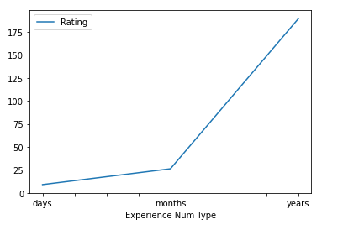
Author's Experience Affect Rating
We can see that the higher the experience of the author the more rating their dataset will get

Slide 20
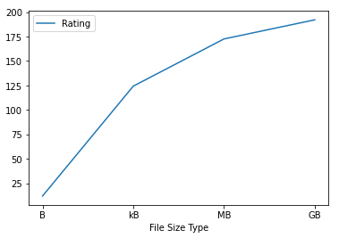
Dataset's Size Affects On Rating
We can see that the bigger the dataset's size the higher the rating for the dataset

Slide 21
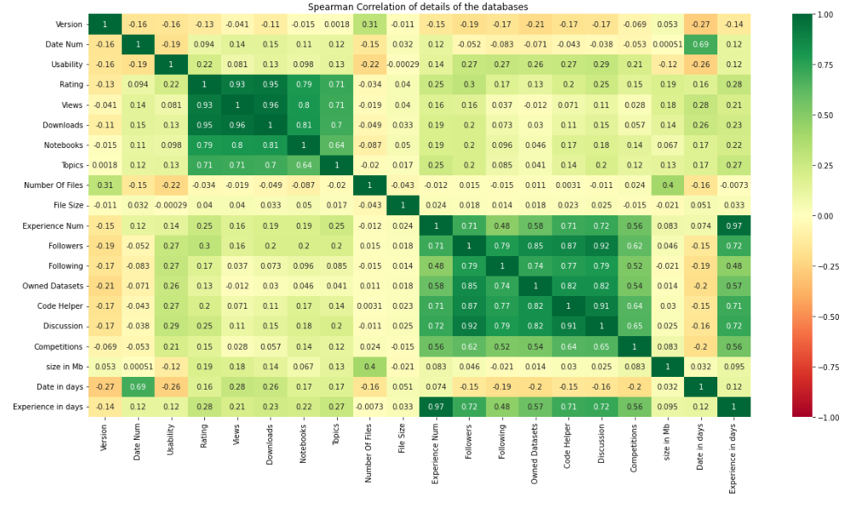
Spearman Correlation
Using spearman we search for possible correlation between 2 columns. As we can see there are 2 squares that have good correlation
Top left green square responds to correlations for the datasets
Right bottom square responds to correlations for the authors

Slide 22
Why Spearman And Not Pearson
Pearson relies on data that is normally distributed and Spearman solves this in the form of the use of ranks. Spearman does not require the data to be distributed normally

Slide 23
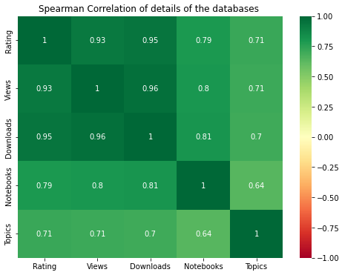
Best Posible Correlation Between Columns For Dataset
We can see that these columns have a very high correlation so we will focus on them

Slide 24
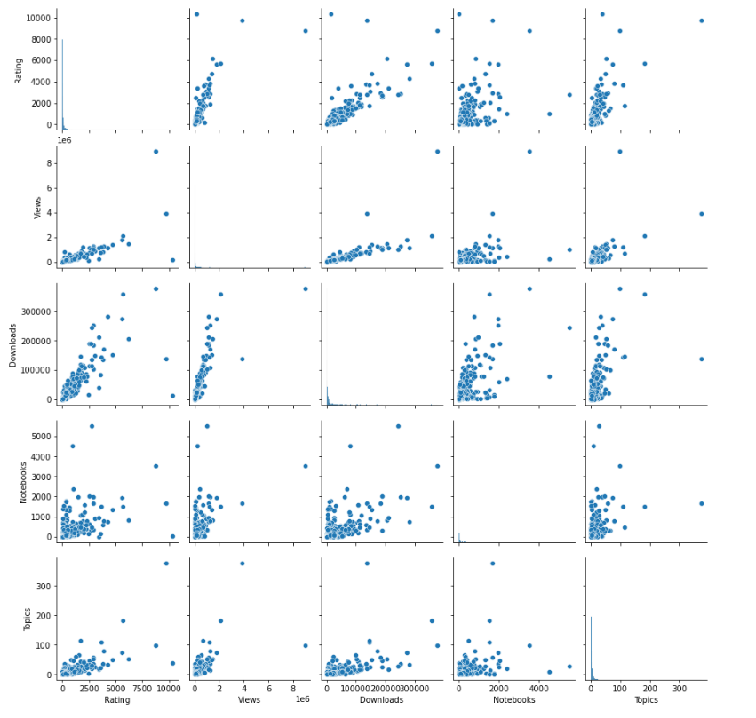
Spearman Correlation(in ratio)
This is the same graph as the spearman graph in the previous page only here we show the linear relation of the columns

Slide 25
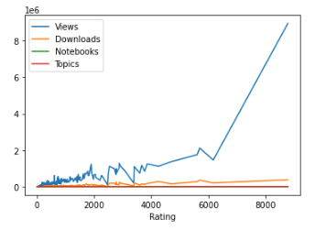
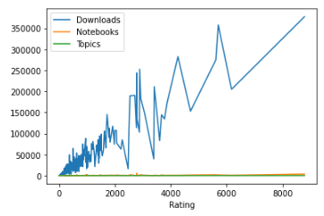
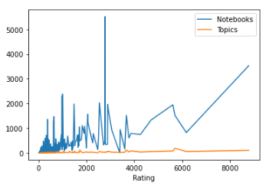
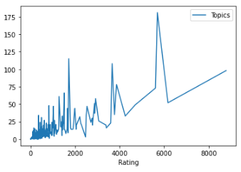
Relation Between The Columns And Rating
We can see that there is an ascending graph for Downloads, Views, Notebooks and Topics which means there is a relation between these column and ratings

Slide 26
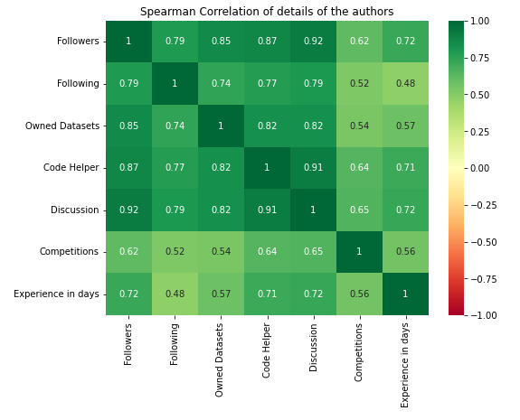
Best Posible Correlation Between Columns For Author
We can see that these columns have a very high correlation so we will focus on them

Slide 27
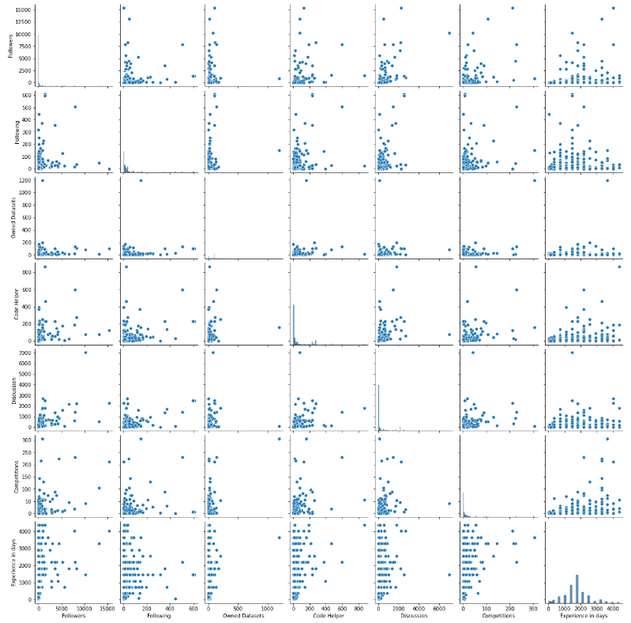
Spearman Correlation(in ratio)
This is the same graph as the spearman graph in the previous page only here we show the linear connection of the columns

Slide 28
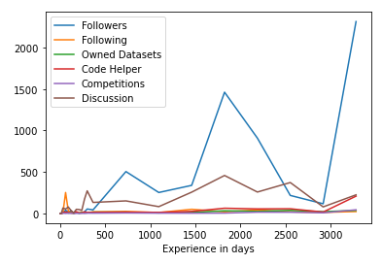
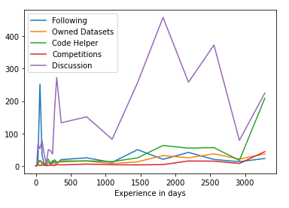
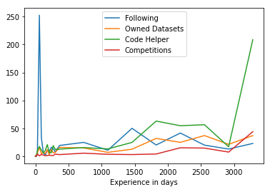
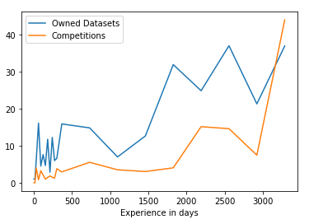
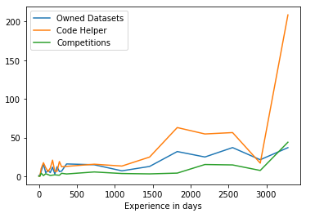
Relation Between The Columns And Author's Experience
We can see a noticeable ascension as a dependency on Experience of the author

Slide 29

Machine Learning

Slide 30

Machine Learning
For this phase we are using regression models in order to see if we indeed can predict the popularity (the rating and the views) of a freshly new dataset in KAGGLE website.
Before Machine Learning Process
Firstly we remove non-numeric columns, removing outliers with IQR, scaling the data with standartScalar and removing the most correlated data(because they do not add any new information)
Machine Learning Process
The reason for using regression models is because we want to predict on continuous variables. We searched for the regression model with the best prediction results from the following regressions
Linear Regression
Ridge Regression
Lasso Regression
KNN Regression
Random Forest Regression

Slide 31
Predicting How Much Rating A New DataSet Will Get
Preparing The Dataset
Splitting the data into train and test
Removing the outliers
Scaling the data
Removing the correlated columns
Creating A DataFrame To Compare All The Models
R2 – R^2 (coefficient of determination) regression score function.
RMSE - root-mean-square-error
Cross Validation - using the cross validation to check if there is an overfitting

Slide 32
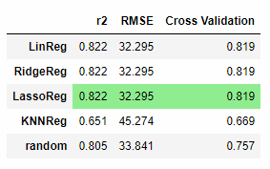
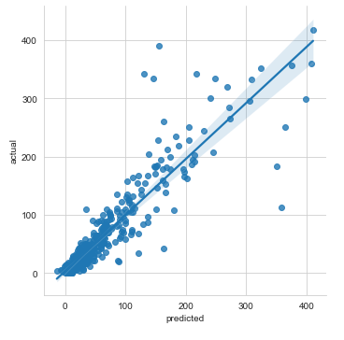
The Best Model According To Results
Best Model Plot
Results
According to the result the best model is Lasso Regression model with an accuracy of 82.2% with r2. We found a successful regression model that will predict the rating of a new dataset

Slide 33
Predicting How Much Views A New DataSet Will Get
Preparing The Dataset(same as before)
Splitting the data into train and test
Removing the outliers
Scaling the data
Removing the correlated columns

Slide 34
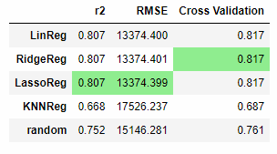
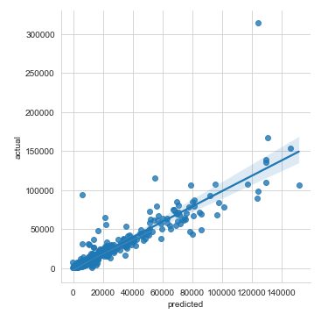
The Best Model According To Results
Best Model Plot
Results
According to the results the best model is Lasso Regression. We got an accuracy of 80.7% with r2 on our best model. We found a successful regression model that will predict the views of a new dataset

Slide 35
Conclusion
We were able to predict using data science and machine learning algorithms with a high success rate for rating and the number of views for a new dataset on the KAGGLE website
For rating we got: 82.2% accuracy with Lasso Regression model
For views we got: 80.7% accuracy with Lasso Regression model

